Slide 1
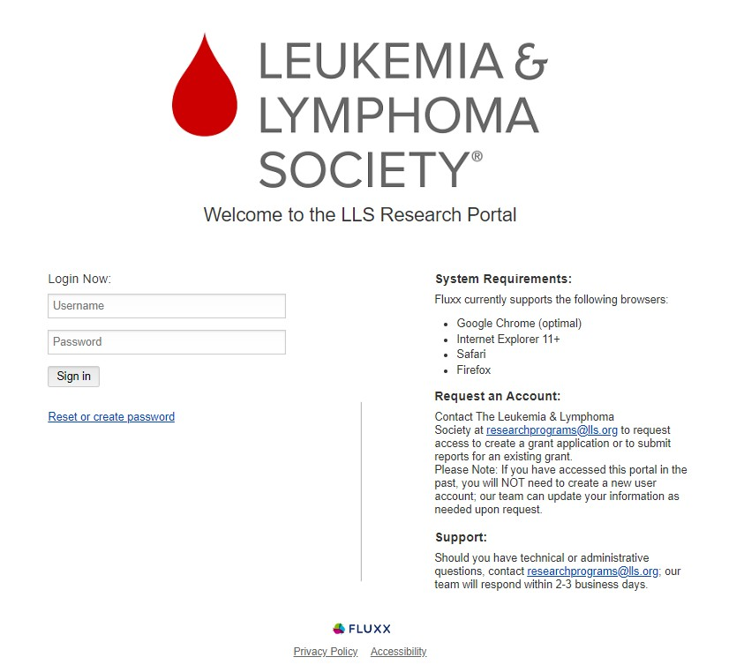
Step 1: Log in to the LLS Research Portal (https://lls.fluxx.io/)
If you forgot your username and/or password, please click the ‘Reset or create password’ link under the ‘Sign In’ button.
If you are new to the portal and require an account, please contact ResearchPrograms@lls.org.

Slide 2
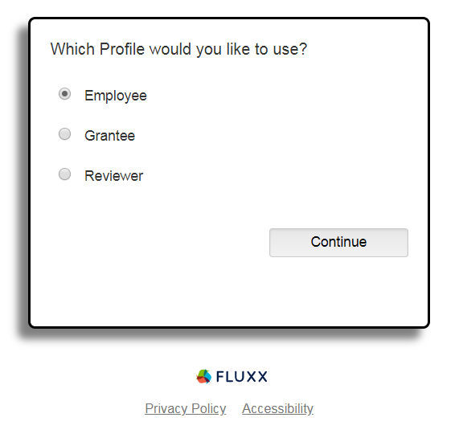
Step 2: If given the option, select Grantee as the profile you would like to use.

Slide 3
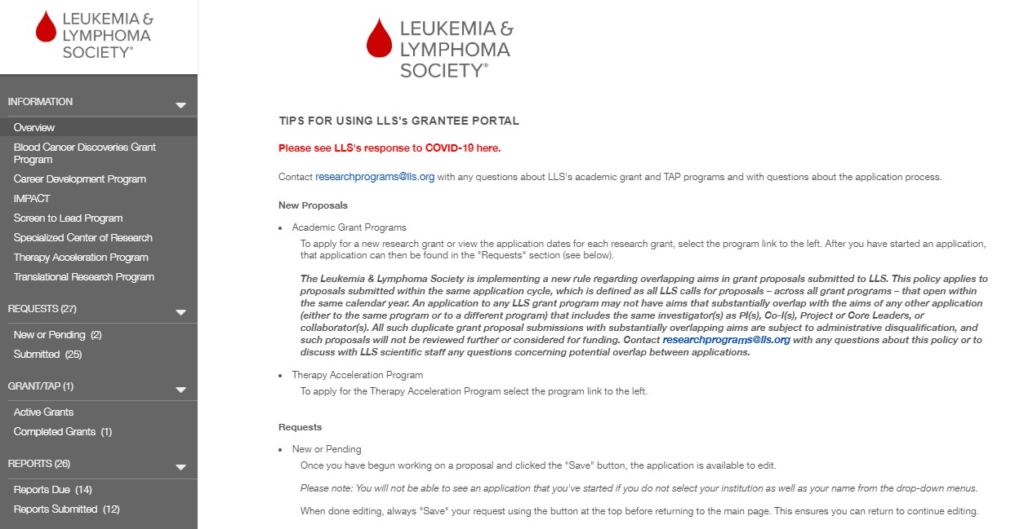
Step 3: On the left panel, scroll to Reports Due and click this link.

Slide 4
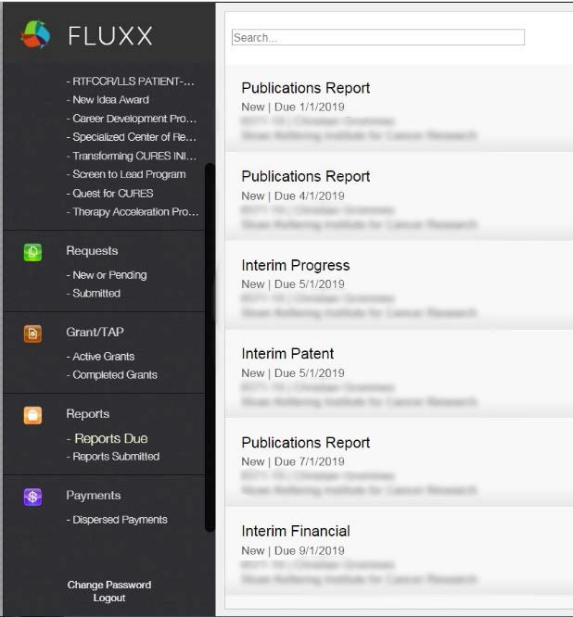
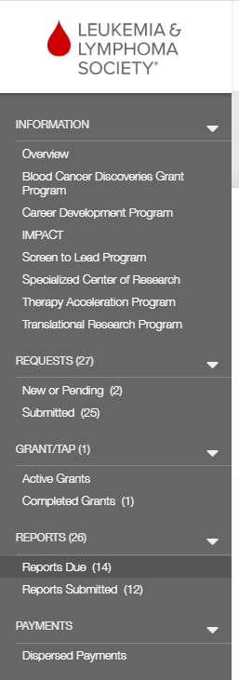
Step 4: Select the report from the list.
Reports are listed in order of Due Date, with the earliest-due report listed first.
Contact ResearchPrograms@lls.org if the report you need to submit is not listed.

Slide 5
Step 5: Download the Report Document.
For Publications Reports, skip to Step 9.
Scroll to the bottom of the page and click this link to download the current report template.
(Do not reuse templates from previous years, as they are subject to change).

Slide 6
Step 6 (for Progress Report): Complete the Report Document
Follow the instructions on the Report Document (example of instructions shown above).
Progress Reports documents should include a detailed description of the research progress and results of the current reporting period, with figures, pictures, tables, etc.
The web form is separate – do not add fields from the web form to the report document.
Be sure to obtain all requested signatures, if applicable.

Slide 7
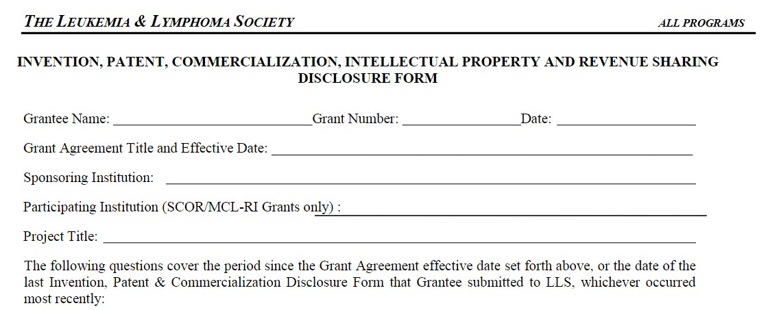
Step 6 (for IP Disclosure Report): Complete the Report Document
Follow the instructions on the report template. Do not skip any fields.
Make sure the heading of your template matches that in the above image. If not, download the current template from Fluxx (see Step 5). Outdated templates will not be accepted.
This report must be routed through your institution’s Technology Transfer office and signed by an official in that office. Reports missing an official signature will not be accepted.

Slide 8
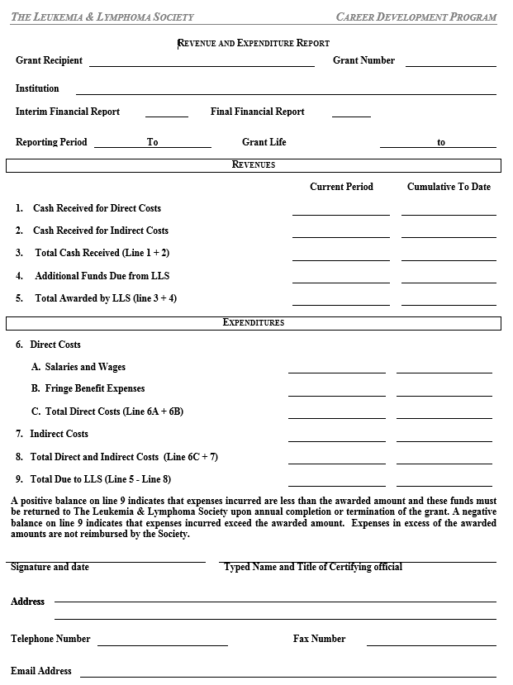
Step 6 (for Financial Report): Complete the Report Document
Be sure to use a new template file downloaded from this report’s page (see Step 5). Templates vary from program to program and are subject to change periodically.
This report must be routed through your institution’s Finance office and signed by an official in that office.
Reports missing an official signature will not be accepted.
Complete the template, filling in each field in both the “Current Period” and “Cumulative to Date” columns. For the Year 1 report, these columns should match.
If there is a positive balance for line 9, further action is required. Some awards have the option to carry forward unspent funds into the next year. This request can be submitted with the Financial Report. Check the LLS Policies & Procedures (available at LLS.org) to see if your award qualifies.
If carry forward is not permitted, or if this is the last year of the award and a no-cost extension is not permitted or approved, a refund check must be sent to LLS.

Slide 9
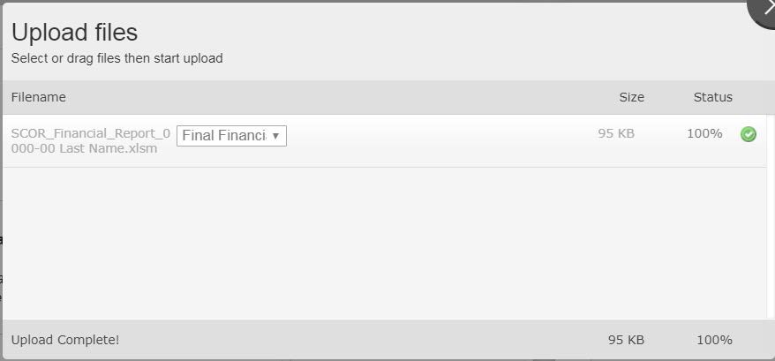
Step 7: Upload the completed Report Document as a PDF file.
Click this symbol to open the uploader.
Drag files into the uploader window or click “Add Files.” Then, click “Start Upload.” Once the Status shows 100%, the upload is complete. Close the window, and you should see the file in the gray Report Documents box.

Slide 10
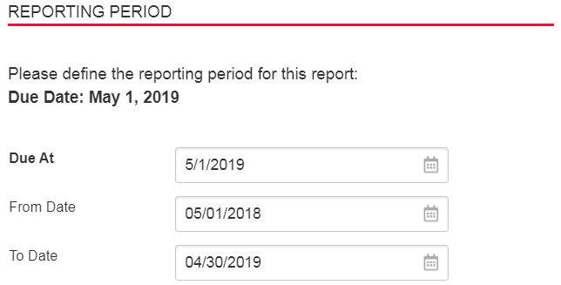
Step 8: Begin the Web Form.
Start by clicking Edit at the top right of the page.
(Contact Researchprograms@lls.org if you do not see an Edit button).
Once in edit mode, complete the Reporting Period section of the web form. Please check your Grant/Funding Agreement for reporting periods and due dates.
Reporting Periods will vary in special situations, such as transfers or recent leaves of absence.

Slide 11
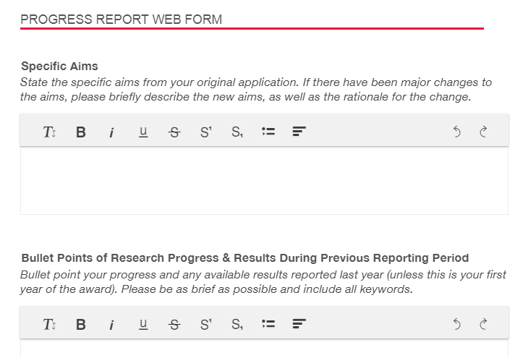
Step 9 (for Progress Report): Complete the Web Form.
Follow the instructions that appear for each field when in edit mode.
Fields that request bullet points must be completed using brief bullet points. Use as few words as possible, leaving in the key components of the research. These fields are informal and should provide LLS staff with a quick snapshot of your progress.
Do not use full paragraphs.
REMEMBER TO SAVE YOUR WORK! Changes are NOT automatically saved, and you may be automatically logged off due to inactivity. To prevent any loss of progress, we highly recommend saving frequently or typing responses on a separate document to paste into the form for submission.

Slide 12
Step 9 (for IP Disclosure Report): Complete the Web Form.
Complete the web form so that the answers match those given in the uploaded document.
Do not skip fields.
Note that a response of “Yes” to certain questions requires additional documentation. This documentation, when required, should be uploaded to the Report Documents section.
REMEMBER TO SAVE YOUR WORK! Changes are NOT automatically saved, and you may be automatically logged off due to inactivity. To prevent any loss of progress, we highly recommend saving frequently.

Slide 13
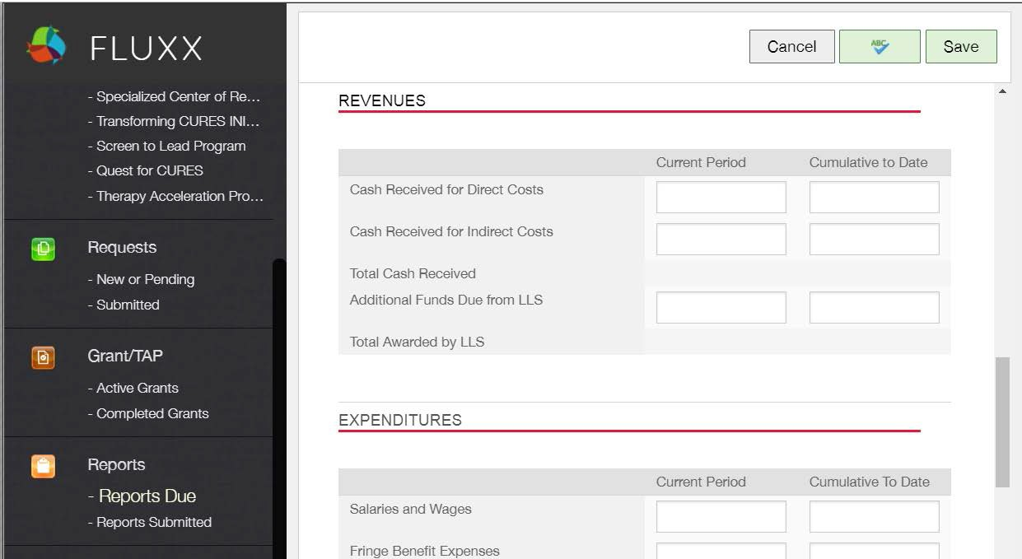
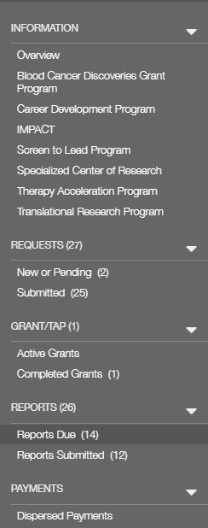
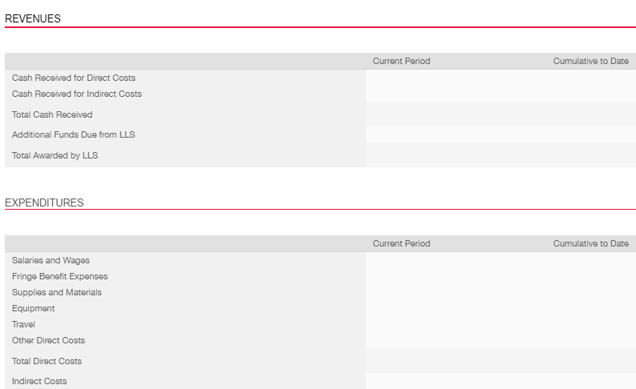
Step 9 (for Financial Report): Complete the Web Form.
Complete the web form so that the answers match those given in the uploaded document.
Do not skip fields.
REMEMBER TO SAVE YOUR WORK! Changes are NOT automatically saved, and you may be automatically logged off due to inactivity. To prevent any loss of progress, we highly recommend saving frequently.

Slide 14
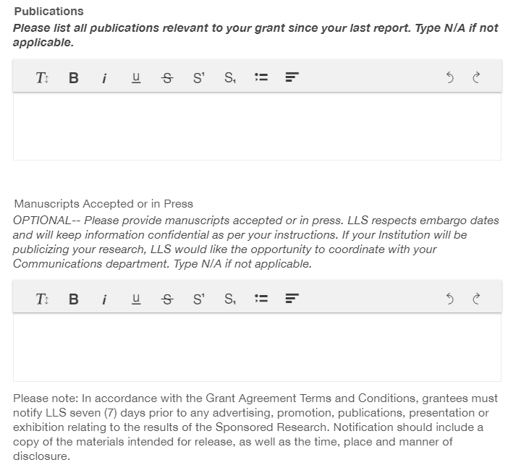
Step 9 (for Publications Report): Complete the Web Form.
Complete the Publications field. The Manuscripts Accepted or in Press field is optional.
REMEMBER TO SAVE YOUR WORK!
Changes are NOT automatically saved, and you may be automatically logged off due to inactivity. To prevent any loss of progress, we highly recommend saving frequently or typing responses on a separate document to paste into the form for submission.

Slide 15
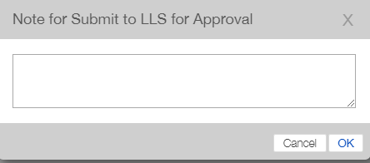
Step 10: Check and Submit Your Report.
Once the report is complete (i.e. the Report Document is uploaded and the Web Form is complete to your satisfaction), click Save. Once the report is saved, click Submit to LLS For Approval located on the bottom right of the screen.
You will be prompted to provide a Note, but this is not necessary. Click OK to proceed.

Slide 16
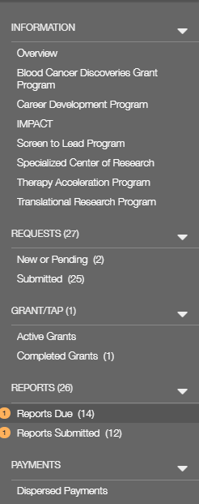
Step 11: Confirm Submission Success.
Successful submission will result in a new entry to your list of Reports Submitted.
Contact ResearchPrograms@lls.org if:
You need to edit the report after submission.
You are not able to see confirmation of submission after refreshing your browser.
You will be contacted and your report will be returned to you if LLS requires revision of your report. Follow directions carefully in order to avoid this.
Email ResearchPrograms@lls.org for clarification of any instructions.

